Slide 1
Covid-19 Incident Rate:
Are Vaccine Mandates Scientifically Bayes-d?
Mitchell Jones & Jan Mooney
Notes:
Mitchell

Slide 2

Background
Debate around public policy actions to reduce spread of COVID-19
Vaccine policy variation among US states
Vaccine mandated
Vaccine not mandated
Vaccine mandate prohibited
Variation in the proportion of population at high risk
Notes:
Jan

Slide 3
Objective
Model the direct association between vaccine policy and COVID-19 incidence rate across US states
Notes:
Jan

Slide 4
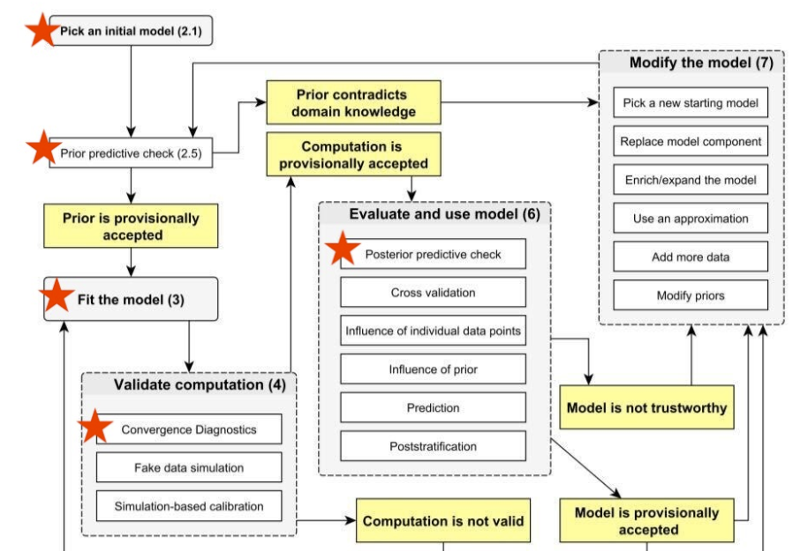
Bayesian Workflow
Notes:
Mitchell

Slide 5
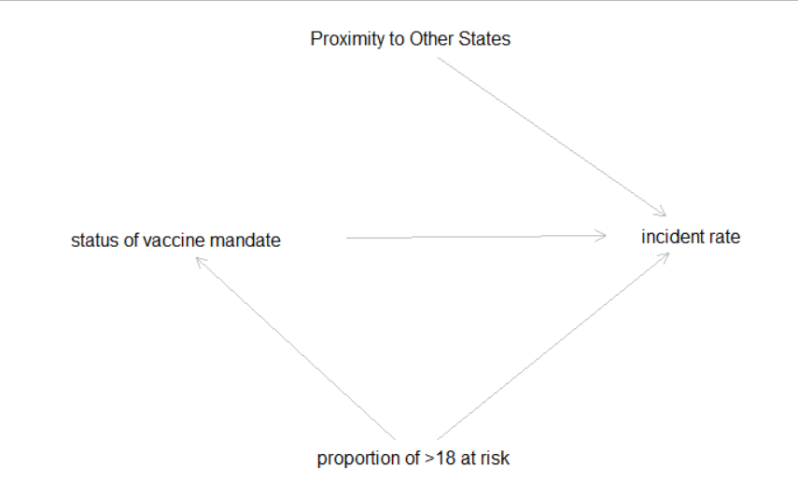
DAG
Notes:
Mitchell

Slide 6
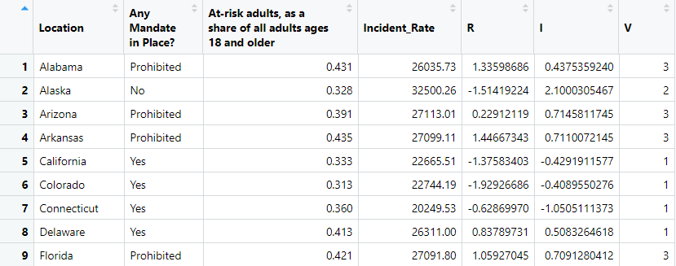
Datasources
Johns Hopkins University COVID-19 databases
Incident rate
Proportion of “at-risk” adults
Vaccine mandate status
Selected one point in time in February 2021, informed by:
vaccine development timeline
initial testing/individual uptake
time for states to consider implementing a mandate
Notes:
Mitchell

Slide 7
Total Effect: Index Variable Only

Slide 8
DAG
Notes:
Mitchell

Slide 9
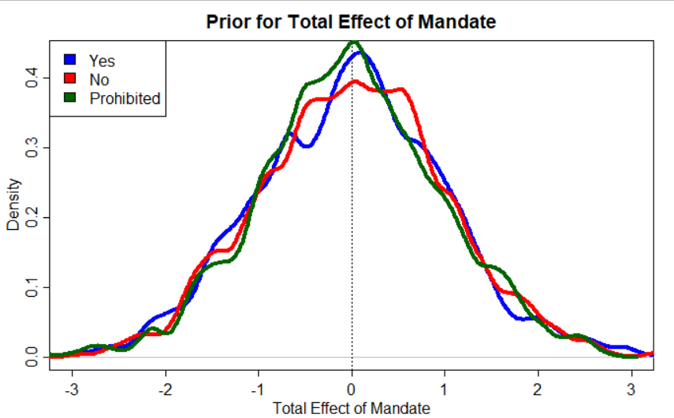
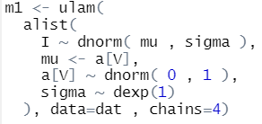
Prior - Total Effect of Mandate
Notes:
Mitchell

Slide 10
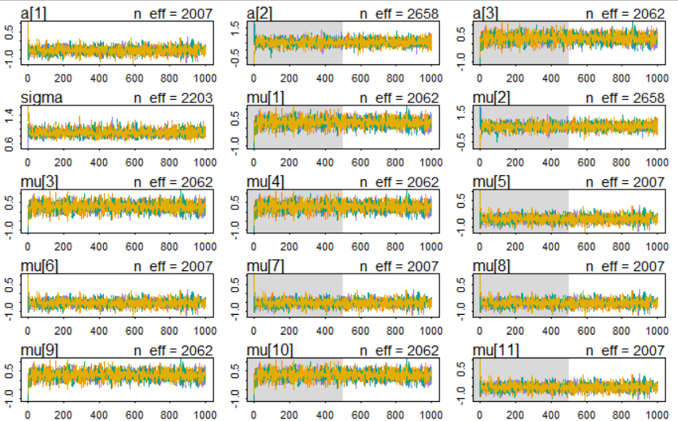

Fit Diagnostics
Notes:
Jan

Slide 11
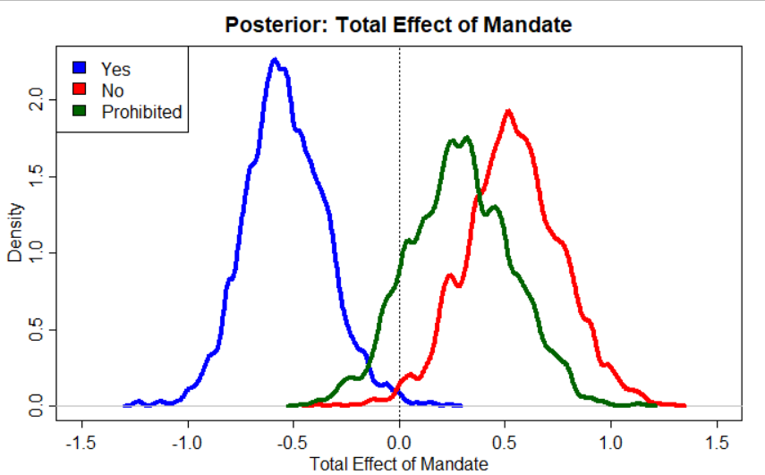
Posterior - Total Effect of Mandate
Notes:
Jan

Slide 12
Direct Effect: Index Variable and Slope

Slide 13
DAG
Notes:
Mitchell

Slide 14
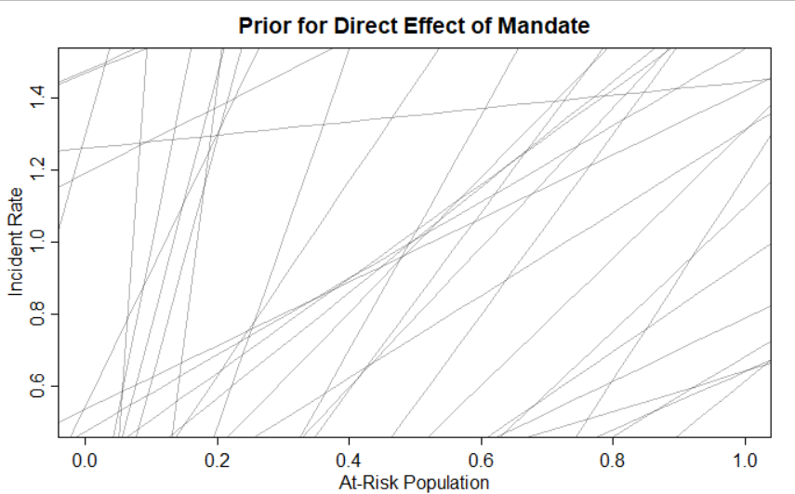
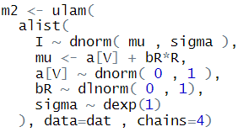
Prior - Direct Effect of Mandate
Notes:
Mitchell

Slide 15
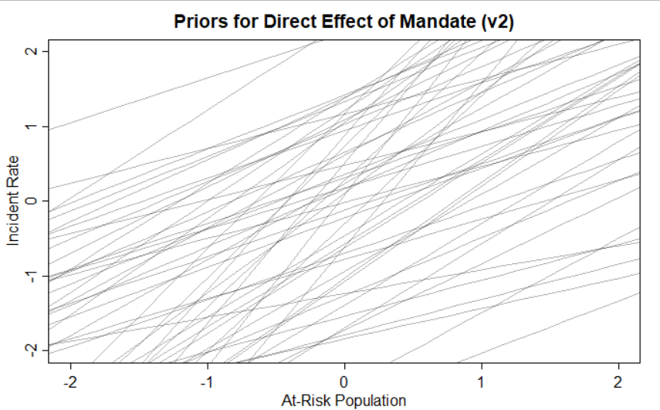
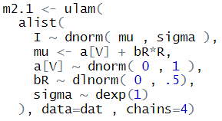
Prior - Direct Effect of Mandate v2
Notes:
Mitchell

Slide 16
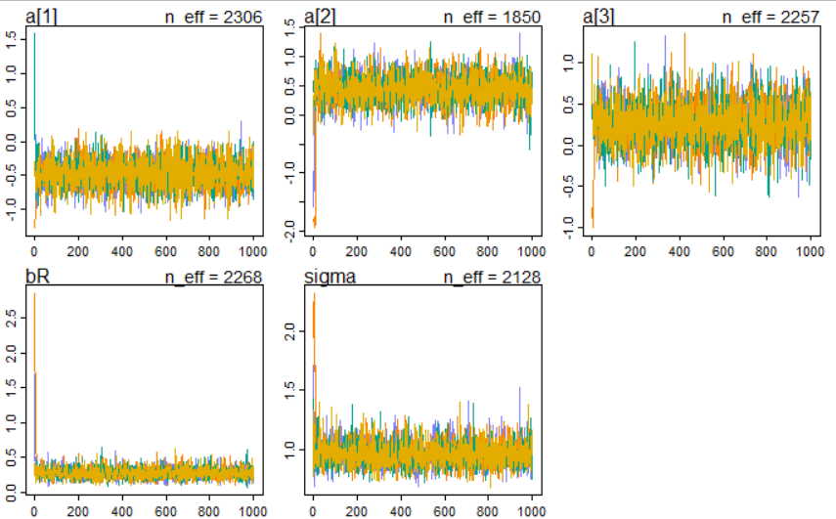
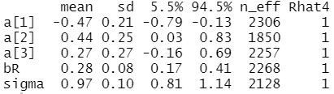
Fit Diagnostics
Notes:
Jan

Slide 17
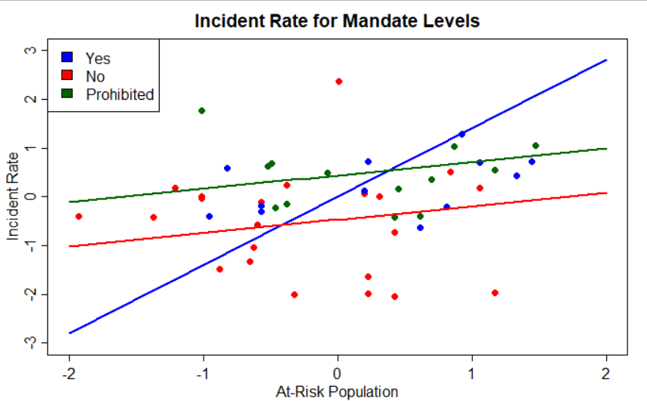
Posterior - Direct Effect of Mandate
Notes:
Jan

Slide 18
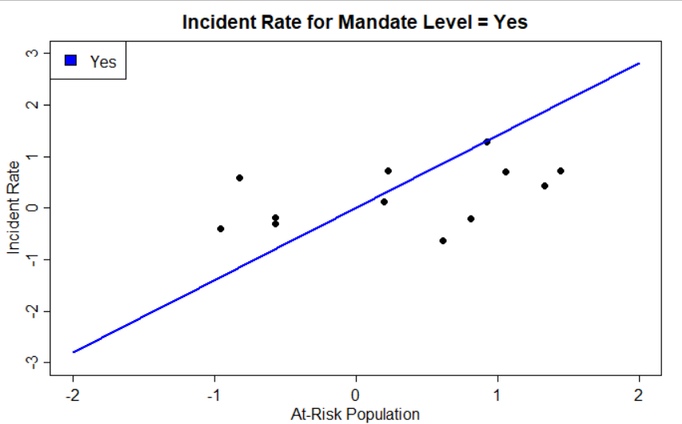
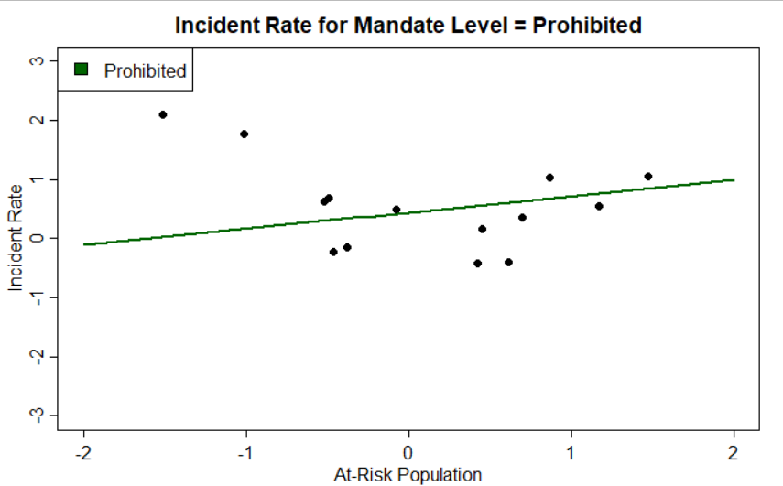
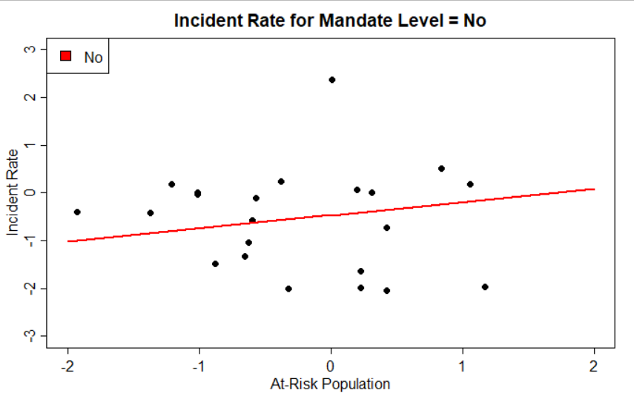
Notes:
Jan

Slide 19
Conclusions
Having a vaccine mandate in place is a context in which there is a strong positive relationship between proportion of population at risk and COVID-19 incidence rate
When there is no mandate or the mandate is prohibited, the incidence rate is higher even when there are fewer individuals in the state who are at risk
Vaccine mandates seem to help reduce overall incidence of COVID-19!
But having a high proportion of individuals who are at risk is still associated with more cases
Notes:
Jan

Slide 20
Strengths & Limitations
use of DAG to conceptualize
conceptually and empirically informed priors
systematic approach to investigation
lots of visualizations!
region/proximity to other states not considered
sociocultural variability not considered
other potential confounds
one snapshot of time
Notes:
Mitchell

Slide 21
Q&A

